Slide 1
OECD S&T Policy 2025 initiative:
Enabling transitions through STI
International Symposium "Towards the transition of sociotechnical system: reflection based on the new science technology and innovation policy by OECD“, Tokyo
17 March 2023
Michael Keenan
Directorate for Science, Technology and Innovation, OECD
michael.keenan@oecd.org
https://www.oecd.org/sti/inno/stpolicy2025/

Slide 2

Presentation outline
Policy context today
Main assumptions and orientation of the OECD’s S&T Policy 2025 initiative
Main elements of the initiative
  Guiding vision
  Key policy challenge guidance
Timeline and deliverables

Slide 3
The project’s context
A range of global crises, including climate change, resource depletion, biodiversity loss, and the recent COVID-19 pandemic, present the world with unprecedented challenges.
Contemporary configurations of large socio-technical systems in areas like energy, agrifood, mobility, and healthcare may not deliver the change needed in time to avoid various bleak scenarios.
These systems will need to become more sustainable, resilient and inclusive, which will require simultaneous political, economic, behavioural, cultural and technological change, at multiple levels of governance.
STI and STI policy have vital roles to play in enabling transitions in these socio-technical systems.

Slide 4
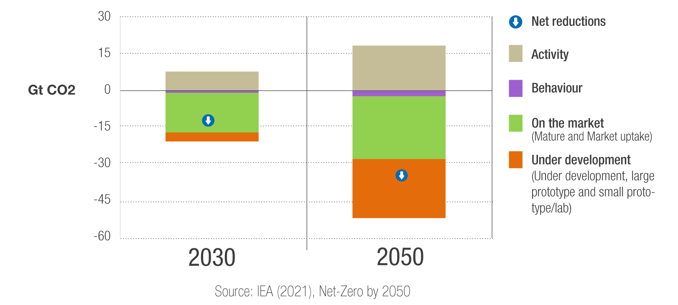
50% of emissions reductions come from technologies that are not yet in the market . . .

Slide 5
… and low carbon R&D and demonstration is not sufficient
Low-carbon public RD&D expenditures in GDP across IEA countries (% of GDP), 1974-2020
Note: The “Others” category includes Carbon capture and storage, Hydrogen and fuel cells, Other power and storage technologies, and Other cross-cutting technologies and research. See https://www.iea.org/data-and-statistics/data-product/energy-technology-rd-and-d-budget-database-2 . Source: IEA Energy Technology RD&D Budgets database, December 2022.

Slide 6

STI Outlook 2023 – published yesterday
An OECD flagship publication, most widely read STI output
Published every 2 years, since the mid-1990s
Asks: “What’s new in the field of science, technology and innovation policy?”
The 2023 edition focuses on STI for sustainability transitions in an age of disruptive change
Provides an international review based on latest policy information and indicators
  Based on the work of the Committee for Scientific and Technology Policy (CSTP) and its working parties
  Draws extensively upon OECD STI statistical and qualitative data infrastructures

Slide 7


STI in an age of disruptive change
Global crises mean that managing risk and uncertainty, while promoting resilience, have moved to the fore as rationales for STI policy intervention => growing ‘securitisation’ of STI policy.
Growing geopolitical tensions have also seen concepts like ‘technology sovereignty’ and ‘open strategic autonomy’ strongly emerge as frames for STI policy.
This is at a time when STI policy is called upon to contribute to sustainability transitions in a range of areas, notably energy, food, mobility and health.

Slide 8
Main assumptions of the OECD’s S&T Policy 2025 initiative
The challenge of transforming socio-technical systems calls for a re-think in government policymaking that takes a more systemic view of problems and an inclusive and holistic approach to STI policy interventions.
There exist gaps between current STI policy and governance arrangements and those required for transitions. At the same time, we are not starting at zero, and countries are already implementing relevant policies and governance arrangements.
Fostering wider system change is a major challenge for STI policy makers, since many of the actions will fall in areas outside the direct remit of research ministries or innovation agencies, but where their input, co-ordination, and implementation actions will remain critical.
We are dealing with multi-level transitions, from large-scale socio-technical systems to the provision and use of strategic intelligence for STI policymaking.

Slide 9
Acknowledging multi-level transitions that raise important STI policy questions
Socio-technical transitions of large-scale systems, such as energy, mobility, agrifood, heavy industry, etc.: How to position STI and STI policy in government-wide discourses, strategies and initiatives that address sustainability transitions and resilience?
STI system transitions: How to influence the STI priorities and practices of firms and the public research system, who need to adapt to meet the challenges of sustainability transitions and resilience?
Transitions in STI policy and governance arrangements: How to adapt STI policy priorities and practices to meet the challenges of sustainability transitions and resilience, particularly with respect to their rationales, objectives, instruments and the groups they target?
Transitions in the provision and use of strategic intelligence: How to develop the knowledge base, frameworks, institutions, learning networks, and capabilities to inform and deliver an STI policy that contributes to sustainability transitions and resilience?
Socio-technical systems
STI systems
STI policy & governance
Strategic intelligence

Slide 10

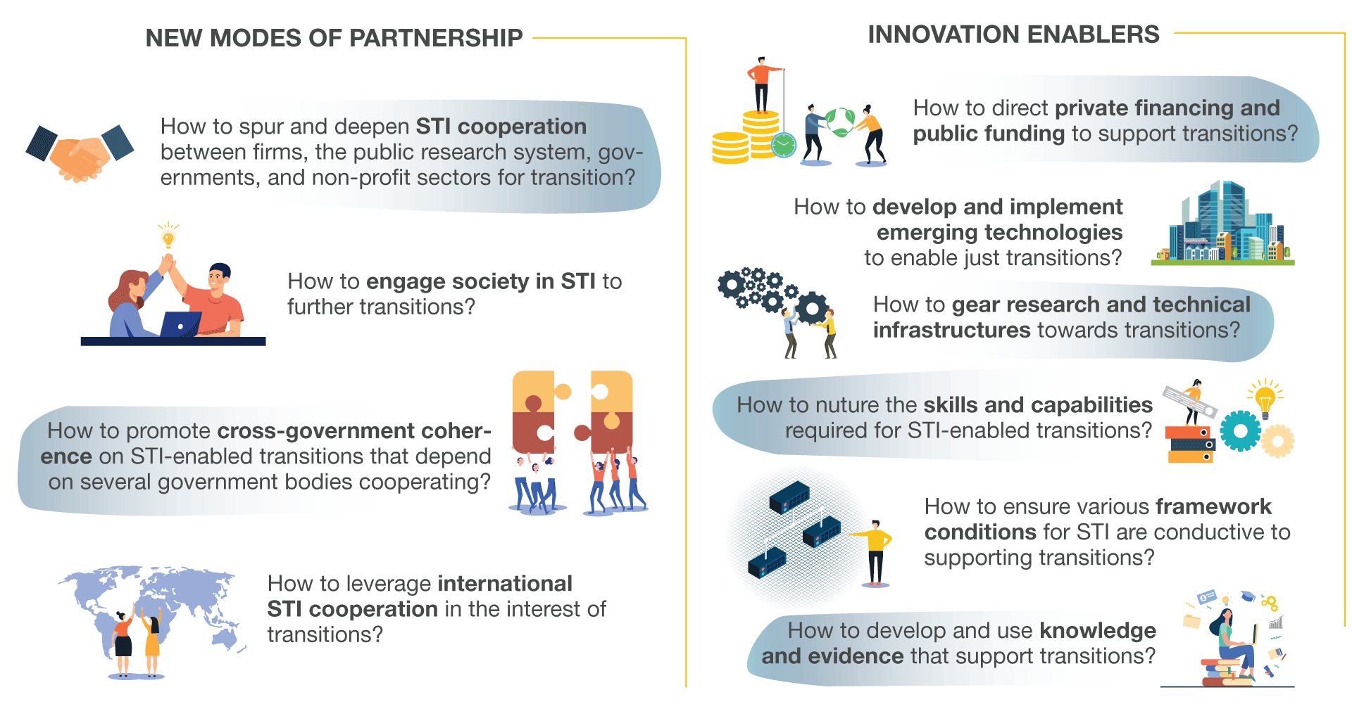
This requires reforms of STI itself
Notes:
The OECD’s flagship S&T Policy 2025 initiative introduces a 10-part framework to help STI policymakers intervene in complex systems in support of sustainability transitions. The framework highlights the main resources (such as STI funding and financing, and skills and capabilities) and relationships (such as societal engagement in STI, and cross-government coordination) that structure and underpin STI systems, and where policymakers will need to enact reforms to reorient their systems towards transition goals.

Slide 11
Harnessing CSTP work to provide systemic guidance on policy reforms
Broadly speaking, the project builds upon and consolidates ongoing and recently completed CSTP and working party projects.
It aims to foster links between them, lend them support where feasible, and to consolidate them into an overarching schema that provides systemic guidance on STI policy reforms.
  Activities and outputs are largely tied to ongoing CSTP and working party projects
  Maps and consolidates this work into stylized policy guidance using harmonized templates
  Adds value by providing a holistic view within a transitions framing
  Also provides new data, analysis and evidence for policymaking and analysis

Slide 12
Main tangible output: S&T Policy 2025 Online Policy Guidance
Overarching Narrative
Why STP25? What does it mean for STI policy?
Guiding vision for STI policy
Linked Resources
Module Narrative + ‘Principles’
What reforms are needed in this area and why? What ‘principles’ should STI policy makers follow?
OECD Publications
Case Studies Repository
x10
Policy Tools Briefs
STI.Scoreboard Statistics
Key Policy Challenge Guidance
Step-by-step online policy guidance on defining the policy challenge, mapping the system, and sequencing actions
x2/3 per module
STIP Compass

Slide 13
Guiding vision: what and why?
Captures the values and goals that STI policymakers and analysts should keep in mind when formulating, designing, implementing and evaluating policy interventions and governance arrangements in support of transitions.
It should be inspirational and aspirational, but also practically applicable in STI policy settings.
It should also serve as the S&T Policy 2025 initiative’s ‘guiding star’, providing a reference point for the project’s other components, in particular, its systemic policy guidance.
We created a first draft in 2022. This is organised into a series of interconnected values and commitments that cover the purposes and practices of STI policy.
There are strong synergies between these values and commitments, but there may also be tensions and trade-offs.

Slide 14
Guiding vision statement: STI policy purpose
Government support to STI activities has long held increased economic competitiveness as its primary target, but a range of global challenges, including the climate crisis, resource depletion, biodiversity loss, and the recent COVID-19 pandemic, call for STI policy agendas to embrace a broader set of values and normative goals.
STI policy should promote the transition to sustainability and resilience in socio-technical systems like energy, agrifood, mobility, and healthcare. These transitions should be just and have democratic legitimacy. They should embody different forms of inclusivity in STI, for example, with respect to differences in geography, socio-economic status, gender, and ethnicity.
In this way, science and technological innovation should offer hope, and mobilise human creativity and ingenuity to tackle the most pressing challenges of our time.
At the same time, STI policy will need to balance challenge-oriented values and goals with academic freedom to pursue R&D activities that advance human knowledge without any specific use in mind.

Slide 15





Guiding vision: values and commitments (1)
Diversity: Foster resilience by supporting a range of research and technology areas, involving diverse actors working on different challenges.
Directionality: Prioritise research and technological development that are most likely to contribute solutions to collectively defined goals, while taking account of the complexity and uncertainty of transitions.
Openness: Support broad participation in science and innovation and sharing of resources that contribute to transparency, trust and collaboration.
Co-operation: Support deliberation and collective action between public, private and non-profit realms, between science and society, across different policy domains and levels of government, and at the international level.
Responsibility: Support research and innovation that are responsive to a wide range of societal challenges, and that periodically review their aims, assumptions, practices and outcomes.

Slide 16





Guiding vision: values and commitments (2)
Sensitivity to context: Embed sensitivity to specific conditions determined by place, sector, policy domain, and type of challenge.
Integrity and ethics: Nurture norms and principles that, for example, constitute good scientific practice, including academic freedom, openness, honesty, and accountability.
Agility: Nurture long-term perspectives, for example, through anticipatory process and policy experimentation that contribute to adaptability and resilience in research, innovation and governance systems.
Accountability: Ensure interventions embody excellence, effectiveness and efficiency considerations, broadly defined.
Evidence-based: Promote the development and use of evidence and knowledge – strategic intelligence – to improve the formulation, design, delivery and evaluation of STI policy interventions, as well as the decisions of other actors in research and innovation systems.

Slide 17
Towards greater directionality in the policy mix
Experiment
Build up
Scale up
Set direction
Shape conditions
Break down
Develop governance and institutional capacity for transitions

Slide 18
Key Policy Challenge Guidance
Articulate the key policy challenge in the local context. For example, why does the key policy challenge present a problem and how does it manifest itself? Is it widely perceived as a problem and by whom? What are the root causes of the problem and to what extent can these be tackled by STI policy? What policy interventions are already being pursued and how are they performing?
Considering insights from the previous steps, list the main actions required to realise the future desirable vision. Actions will include measures to experiment with, scale-up and institutionalise new technologies, new institutional arrangements, etc. They will also include measures to challenge and ‘destabilise’ existing arrangements that hinder progress to realising the desirable vision.
Map the main actors (e.g. their roles, interests, linkages) and factors (e.g. resources (such as finance, skills, data), institutions) that influence the current landscape and that are expected to play significant roles in realising the desirable future vision.
Problem definition
Vision formulation
Situational analysis
Enablers & challenges
List of actions
Action
sequencing
Formulate a desirable future vision of what success would look like in tackling the key policy challenge and (at a high-level) how this could be achieved. As far as possible, this should be a shared vision among the main stakeholders and should have a fixed time horizon, e.g. 10 years into the future. It should be both realistic and ambitious, while anticipating the dynamics of larger trends that could influence the wider landscape.
Use systems thinking insights to help identify and understand critical linkages, synergies and trade-offs between actors’ interests and shaping factors, such as resources. Since reform efforts are often frustrated by lock-in dynamics emanating from elsewhere in the system, it is important to appreciate these. This will help policymakers better recognise policy constraints and identify leverage points where they could act to unblock transition barriers.
Trace transition pathways from the present to the future, highlighting the main actions and conditions against a timeline. Use portfolio management approaches to prioritise actions, while recognising that transitions rarely follow smooth trajectories but proceed unevenly. Use ‘theories of change’ to appreciate how, when and where developments and interventions are expected to have impacts.

Slide 19
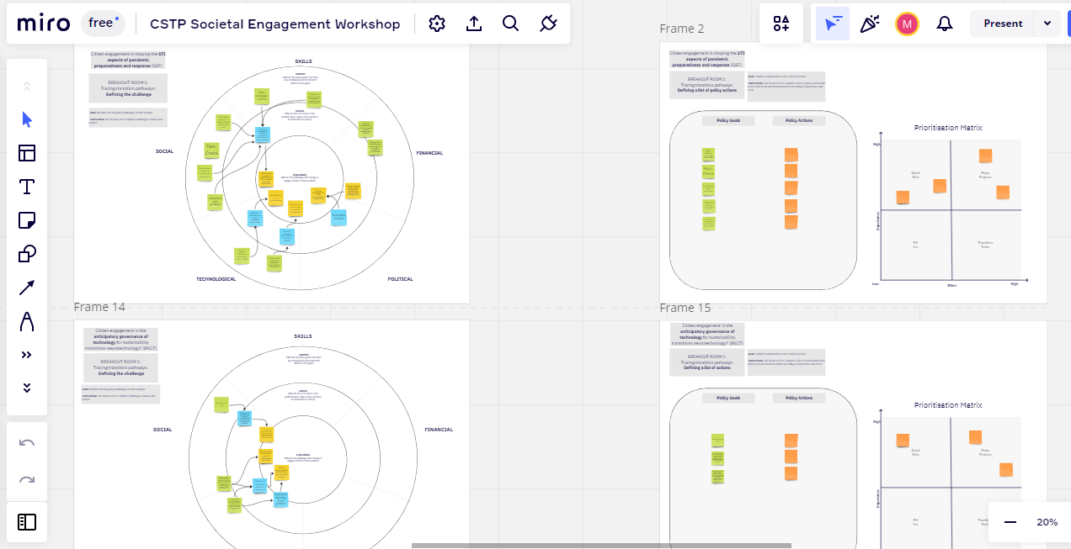
Online guidance with partially prefilled canvasses

Slide 20
Timeline and deliverables
We have a hard deadline of publishing elements of the policy guidance on topics that will feature in the OECD CSTP Ministerial Meeting (April 2024)
  Guiding vision
  Module narratives and principles – most likely on the topics of societal engagement, technology governance, skills and capabilities, and funding and finance
  Key policy challenge guidance – most likely on specific challenges discussed at the Ministerial
Drafts of these will already be ready in late-2023
The remainder of the guidance will be developed during the second half of 2024

Slide 21
Thank-you!
michael.keenan@oecd.org

